Slide 1


WEB APPLICATION PEN-TESTING (WAPT)
Diploma in CSF
Academic Year (AY) 22/23 – October `22
Week 1.1
Hacker’s view of the web
Last Updated: 17/10/2022

Slide 2
Contents
The HTTP Protocol
Activity: Examining HTTP Requests and Responses
Website server architecture

Slide 3
Website Server Architecture

Slide 4
Website server architecture types
Testers need to determine what type of website server architecture they are dealing with
Generally, websites follow one or more of four different architecture types
Web servers
Dynamic servers
Application servers
Proxy servers

Slide 5
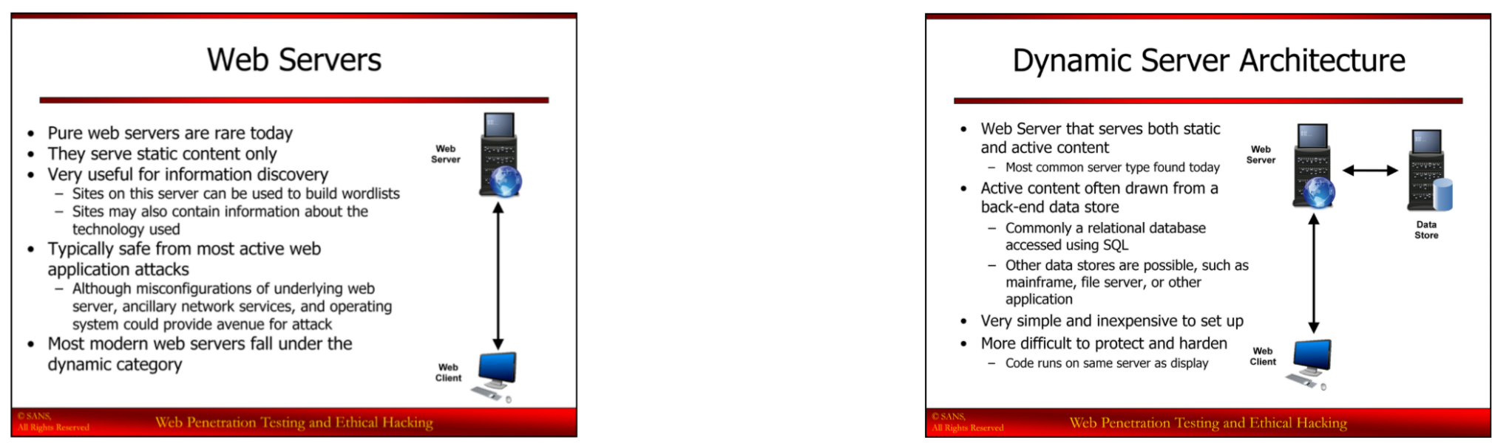
Web servers
Pure web servers are rare today
Serve static content only
Very useful for information discovery
Typically safe from active web application attacks
Most modern web servers fall under the dynamic category

Slide 6
Dynamic Web Server Architecture
Web server that serves both static and active content
Active content often drawn from a back-end data store
Commonly a relational database accessed using SQL
Other data stores are possible such as mainframe, file server, or other application
Very simple and inexpensive to setup
More difficult to protect and harden
Code runs on same server as display

Slide 7
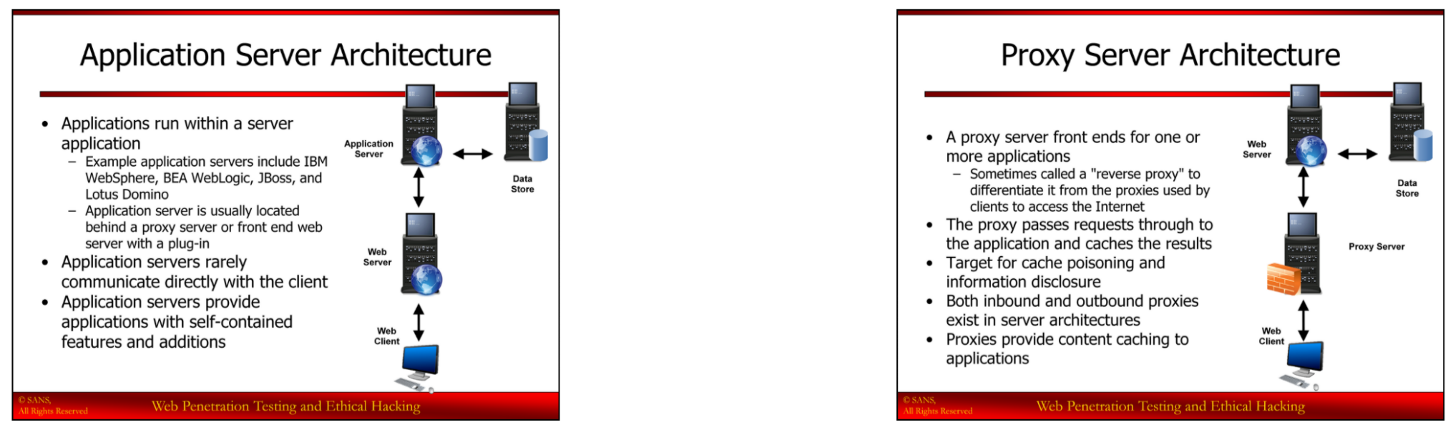
Application Server Architecture
Applications run within a server application
Example application servers include IBM WebSphere, BEA WebLogic, JBoss, and Lotus Domino
Application server is usually located behind a proxy server or front end web server with a plug-in
Application servers rarely communicate with the client
Applications servers provide applications with self-contained features and additions

Slide 8
Proxy Server Architecture
A proxy server front ends for one or more applications
Sometimes called a “reverse proxy” to differentiate it from the proxies used by clients to access the internet
The proxy passes requests through to the application and caches the results
Target for cache poisoning and information disclosure
Both inbound and outbound proxies exist in server architectures
Proxies provide content caching to applications

Slide 9
Hacker’s view of website server architecture
Knowing the architecture makes attacking it easier
Many architectures add features which can be targeted
First, consider what is the target?
Usually, the application and its data
And, those can be a vehicle for attacking the enterprise network behind the site
Allows the pen tester to pivot through web applications to gain access to critical intranet devices – verify that such attacks are allowed in scope
The website server architecture may also open attack vectors
Cache poisoning against proxies (defacing the site)
Source code disclosure attacks against application servers

Slide 10
The HTTP Protocol

Slide 11
HTTP Protocol
Hypertext Transfer Protocol (HTTP)
HTTP is a request/response protocol using TCP for reliable transport
HTTP Versions
HTTP/1 - 1996
HTTP/1.1 – 1997 (Updated: 1999, 2014)
HTTP/2 – 2015
HTTP/3 – 2022

Slide 12
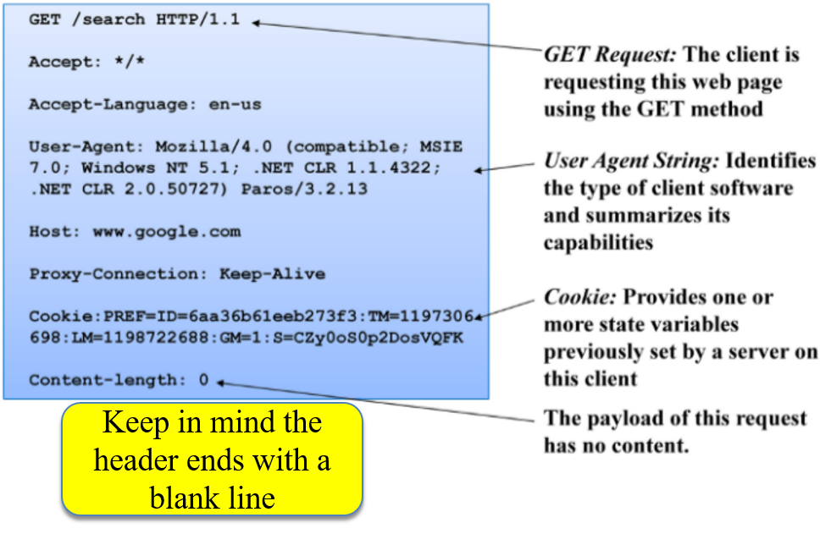
Example HTTP Request
A request contains a number of header fields
Most of these fields are optional and added by the client or the application
The server can use the user agent string to change its logic

Slide 13
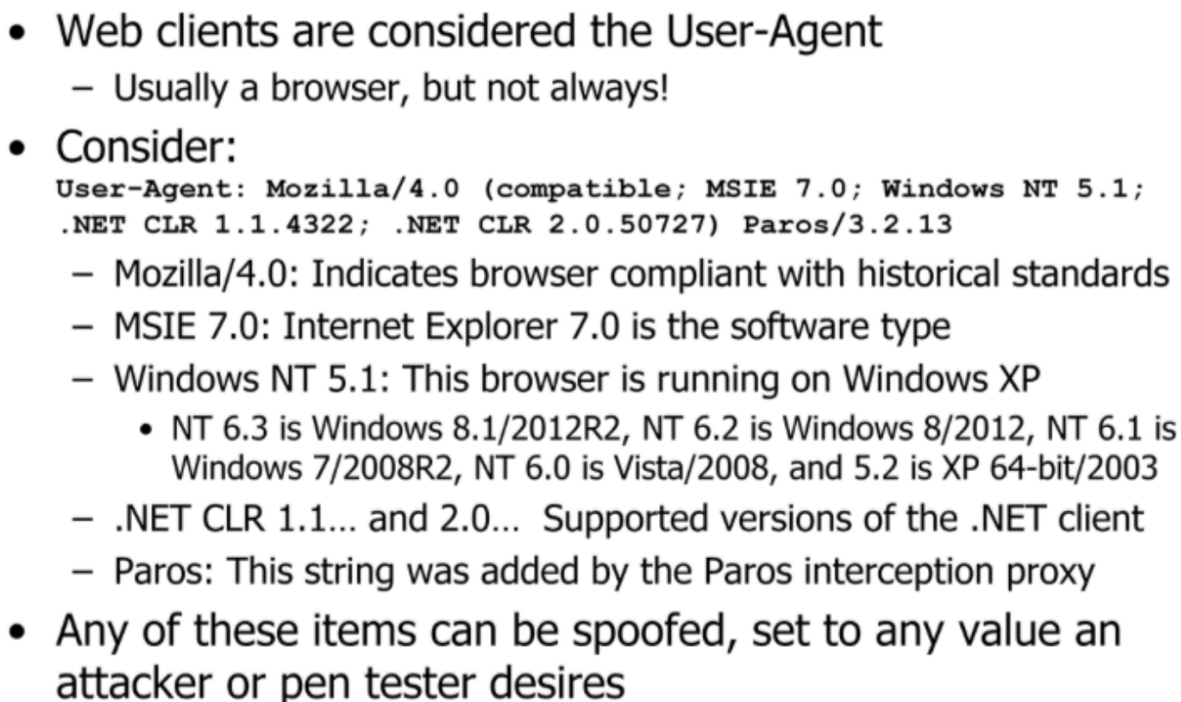
User Agent

Slide 14
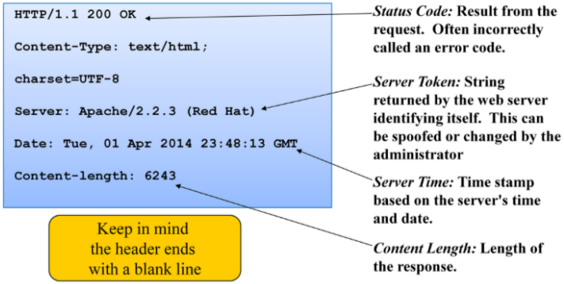
Example HTTP Response

Slide 15
Activity 1.1
When a pen-tester point the URL of his Firefox browser to https://www.ibm.com
The communications between his browser and the IBM servers were captured and given in the next five slides, separate them as REQUEST or RESPONSE message.
Use ZAP Proxy Tool.
Intercept HTTP Request and Response Headers
10/18/2022
1020-WAPT-Session 2.1-Reconnaissance Basic
15

Slide 16
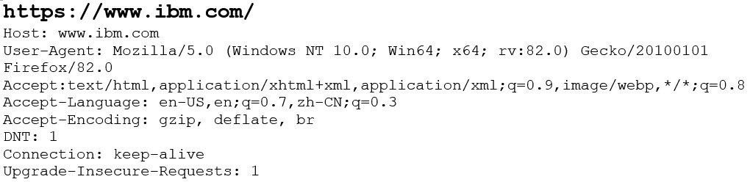
Activity 1.1
16

Slide 17
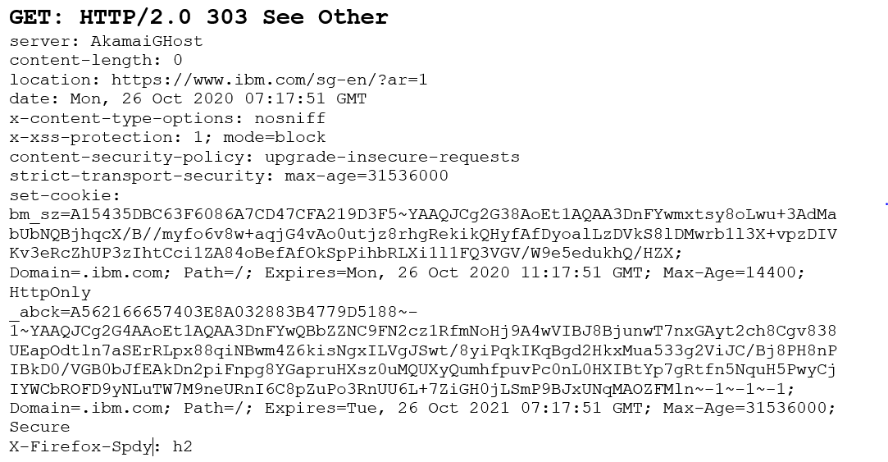
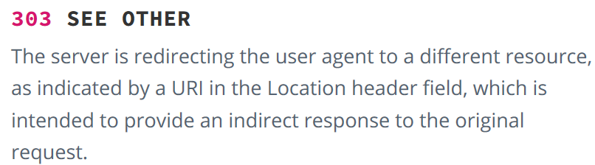
Activity 1.1
https://developer.mozilla.org/en-US/docs/Web/HTTP/Status/303
17

Slide 18
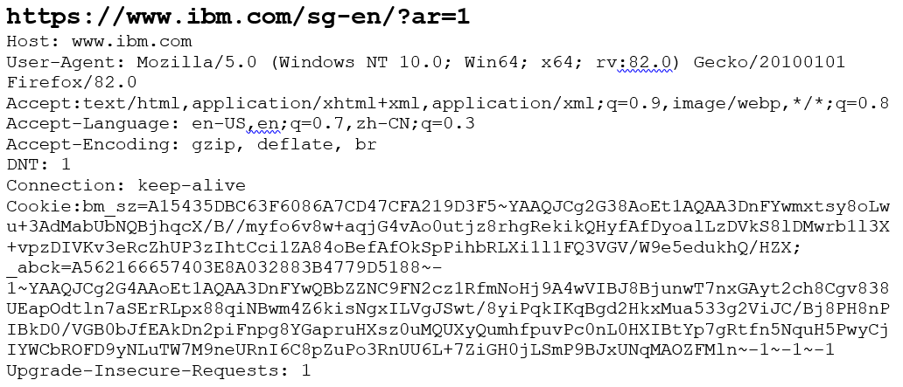
Activity 1.1
18

Slide 19
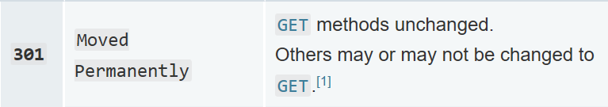
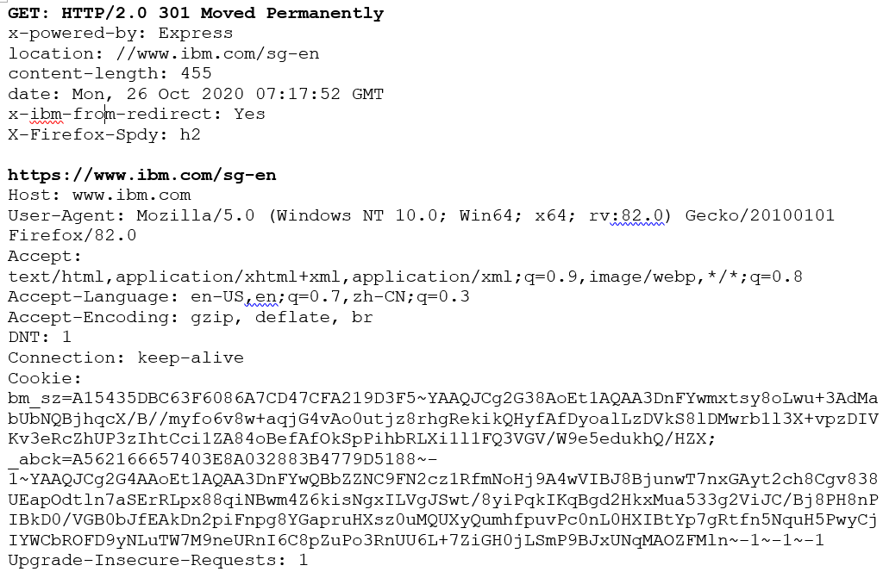
Activity 1.1
https://developer.mozilla.org/en-US/docs/Web/HTTP/Status/301
19

Slide 20
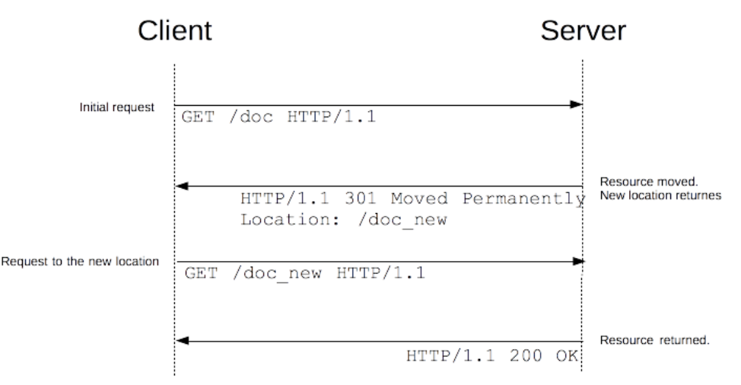
Activity 1.1
Source - https://developer.mozilla.org/en-US/docs/Web/HTTP/Redirections
20

Slide 21
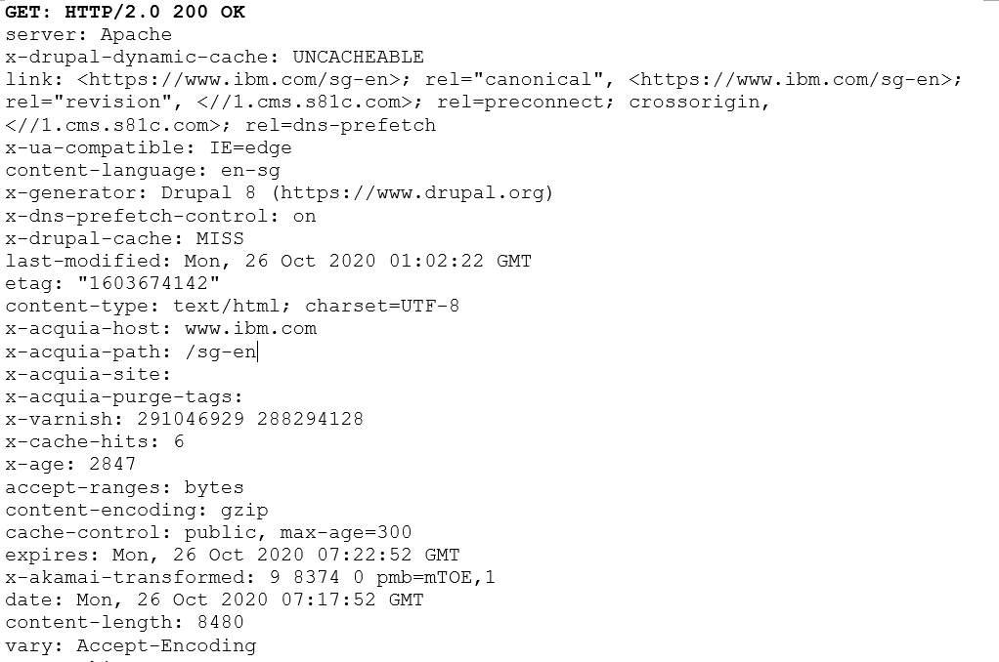
Activity 1.1
21

Slide 22
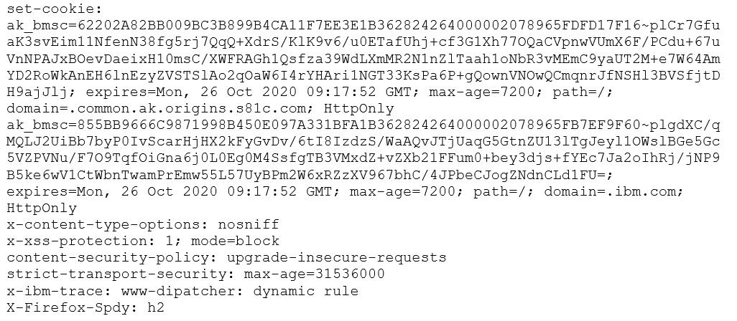
Activity 1.1
22

Slide 23
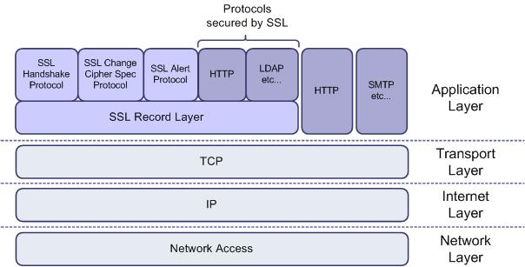
HTTPS ?

Slide 24
Classes of HTTP Status Codes
100s: Informational codes indicating that the request initiated by the browser is continuing.
200s: Success codes returned when browser request was received, understood, and processed by the server.
300s: Redirection codes returned when a new resource has been substituted for the requested resource.
400s: Client error codes indicating that there was a problem with the request.
500s: Server error codes indicating that the request was accepted, but that an error on the server prevented the fulfillment of the request.

Slide 25
End of Session 1.1

